Slide 1
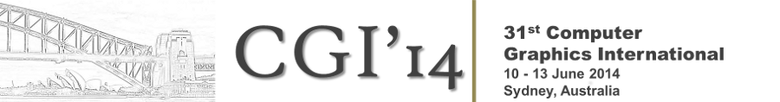



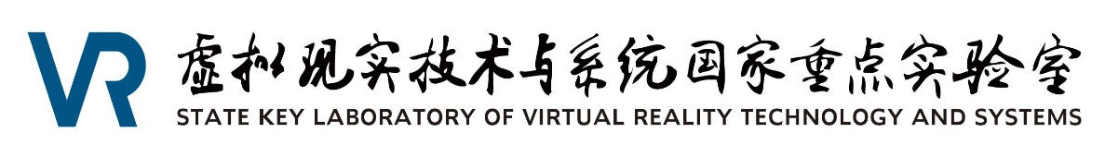
Parallelized 4D Structure, Shape, and Motion Reconstruction of Vessels from Multiview X-Ray Angiograms
Xinglong Liu¹, Fei Hou¹ , Aimin Hao¹, Hong Qin²
¹State Key Laboratory of Virtual Reality Technology
and Systems, Beihang University, China
liu3xing3long@163.com
²Stony Brook University, Stony Brook, USA
qin@cs.sunysb.edu
Notes:
Hello, everyone, the topic of my presentation is the “Parallelized 4D Structure, Shape, and Motion Reconstruction of Vessels
from Multiview X-Ray Angiograms”. I am Xinglong liu , from beihang university.

Slide 2
Outline
Introduction
Algorithms
Results
Conclusions
Notes:
This is an outline of my presentation. I will introduce our work in four sections. First, we will begin with
The introduction, then we will talk about the algorithms we used in our paper. Next, results on both clinical
Data and synthetic data will be shown. Finally, we will end with conclusions.

Slide 3
Related Work
Vessel Extraction
Skeleton Extraction
3D Reconstruction
Motion Tracking
Notes:
According to the pipeline of our method, the inputs are original x-ray medical images, the final results are time-relevant reconstructed vessels.
There are four major steps during the reconstruction. we will review the related work from the corresponding topics.

Slide 4
Related Work
Vessel Extraction
  [Hoover et al. TMI(2000)]
  [Li et al. Expert Systems with Applications (2012)]
  [Frangi et al. MICCAI’98]
  [Condurache et al. IAPR (2005)]
  [Zhang et al. Computers in Biology and Medicine (2010)]
Skeleton Extraction
3D Reconstruction
Motion Tracking
Notes:
The first are vessel extraction techniques.
Hoover et al. [1] used a mathematical filter to entails a broad range of vessel enhancement.
Li et al. [2] conducted this task using a non-linear filter.
Frangi et al. [3] used the eigen values of Hessian matrix to extract the tube-like structures from X-ray images.
Condurache et al. [4] used the Hessian Matrix while adding a hysteresis(hɪstə'riːsɪs) thresholding method to purify the extracted data.
Zhang et al. [5] proposed a novel extension of the matched filter approach which is composed of a zero-mean Gaussian function and the first-order derivative of Gaussian, yet their extraction may lead to more isolated retinal vessels.

Slide 5
Related Work
Vessel Extraction
Skeleton Extraction
  [Van et al. Medical Physics(2007)]
  [Hassouna et al. PAMI(2007)]
  [Zhang et al. Commun.ACM(1984)]
3D Reconstruction
Motion Tracking
Notes:
Van and Hassouna proposed a method based on fast marching, but they can not handle isolated vessels and hard
To be parallelized.
Zhang proposed a two step thinning method. It is based on the eight neighbours of the current point, but they
Can not give exact one-pixel width skeletons. bb

Slide 6
Related Work
Vessel Extraction
Skeleton Extraction
3D Reconstruction
  [Wellnhofer et al. IJCI(1999)]
  [Messenger et al. IJCI(2000)]
  [Movassaghi et al. TMI(2004)]
  [Hansis et al. Physics in Medicine and Biology (2008)]
  [Sarry et al. TMI(2001)]
Motion Tracking
Notes:
Next, we will talk about 3d reconstruction techniques.
1.2 Wellnhofer et al. [12] and Messanger et al. [13] evaluated that 3D reconstructions of coronary arteries from 2D X-ray image sequences and permit accurate results of the real data.
3. Movassaghi et al. [15] used multiple projections for realistic vessel lumen simulation.
4. Hansis et al. [17] had used multiple projections from a single rotational X-ray angiography to reconstruct the 3D centerline and the topology.

Slide 7
Related Work
Vessel Extraction
Skeleton Extraction
3D Reconstruction
Motion Tracking
  [Chen et al. TMI(2003)]
  [Shechter et al. TMI(2003)]
  [Shechter et al. TMI(2006)]
  [Blondel et al. TMI(2006)]
  [Bouattour et al. CAIP(2005)]
  [Schoonenberg et al. Medical Image Analysis(2009)]
Notes:
At last, we will talk about motion tracking techniques.
Chen et al. [27] reconstructed the vessel tree and performed motion tracking on this tree with constraints.
Shechter et al. [29] presented a 3D method for tracking the coronary arteries through a temporal sequence of biplane X-ray angiograms.
On the other side, motion field recovered from each data set is composed of patients’ heart and breath movement, which could be regarded as a function of cardiac phase and respiratory phase. Shechter et al. [30] proposed a parametric model to decompose the motion field into independent cardiac and respiratory components.
Meanwhile, Blondel et al. [31] presented a method to compute 4D tomographic representations of coronary arteries from a single view of rotational mono-plane angiograms based on 4D B-spline solids to model motions.
Bouattour et al. [32] formulated the tracking problem as a 3D-2D registration problem in which the 3D model deforms in space to best fit the given set of 2D angiogram.

Slide 8
Challenges
How to extract vessel structures from blurry medical images precisely and efficiently, facing shortcomings such as viewing angle dependence, blurring, etc.
How to avoid registration between image pairs and enforce constrains during the reconstruction.
How to track and reconstruct the vessels’ motion between sequential image pairs.
Notes:
We have reviewed so many related works, what we face next is the challenges.
During the reconstructions, we have three key challenges. First, during the preprocessing step,
How can we extract the vessel structures from the blurry medical images precisely and efficiently.
Next, during the static reconstruction step , how can we avoid explicit registration and design a
Flexible framework with various constrains. Finally, during the dynamic reconstruction step, how can
We model and track the vessels’ s motion according to the sequential image pairs.

Slide 9
Contributions
An efficient parallelized thinning and refining method for extracting vessel skeletons and key points.
A reconstruction algorithm based on energy theory solved using belief propagation with color, coherence and topological constrains.
A vessel motion tracking system with fully parallelized image processing algorithm and partially parallelized belief propagation.
Notes:
Solving the challenges is what we contribute. First, we propose an An efficient parallelized thinning and refining method for extracting vessel skeletons and key points from medical images.
Second, we propose A reconstruction algorithm based on energy theory solved using belief propagation with constrains. Third, we propose the vessel motion tracking method based on Our static reconstruction system with CUDA.

Slide 10
Outline
Introduction
Algorithms
Results
Conclusions
Notes:
So, next, I will introduce the algorithms in our research.

Slide 11
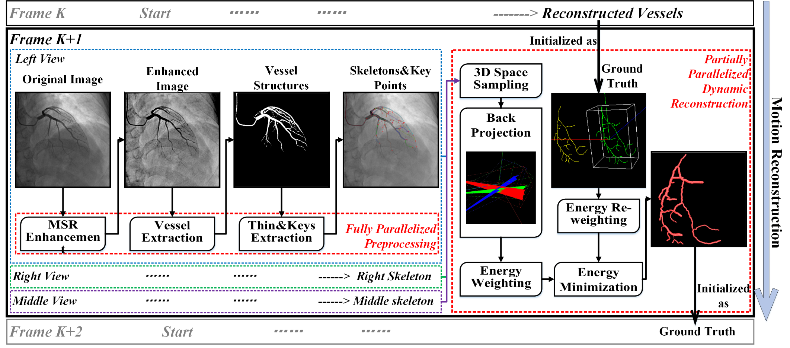
Overview
Notes:
First of all, we will start with the pipeline of our method. This is an overview of our whole processing steps.
Let’s see Inner frame K+1, it is an static reconstruction, and between frame K to frame k+1, it is dynamic reconstruction or the so-called motion reconstruction considering the prior results as the ground truth.
It is based on the assumption that motion between frames is slight with no severe deformations.
According to the flowchart we present, there are majorly three aspects in our computation model, the preprocessing step, the static reconstruction step and the dynamic reconstruction step. We will introduce them one by one.

Slide 12
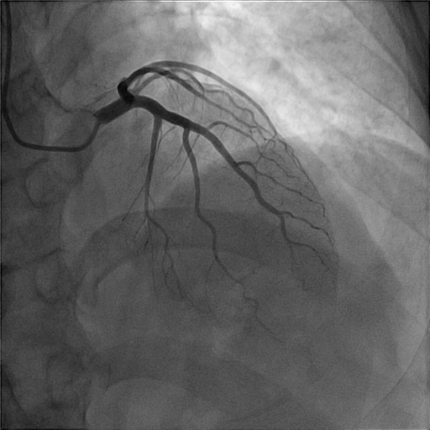


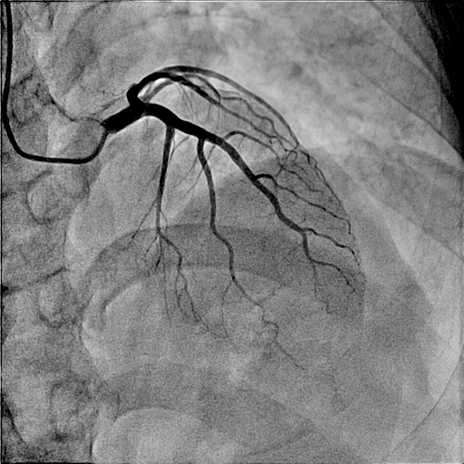

Vessel Enhancement
Vessel Enhancement
Vessel Extraction
Thinning
Feature Extraction
Reconstruction
Notes:
Original images acquired from the machine have many shortcomings such as
Low image contrast, low lumen with wide dynamic range.
To overcome these Shortcomings, we have applied multi-scaled retinex method to the input images.
1. where i stands for the ith channel, K stands for the channel number, Wk
and Fk are the weight coefficients.
After MSR, we use the gain/offset method to fix the negative values of the image.
2. where Ri ( x; y) and Ro( x; y) are the image input and output, R( x; y) is the final grey image.

Slide 13
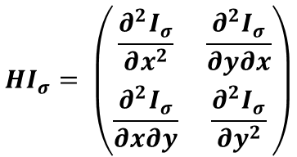

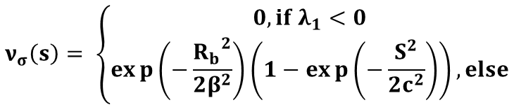

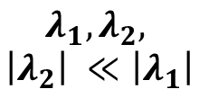
Vessel Extraction
Vessel Enhancement
Vessel Extraction
Thinning
Feature Extraction
Reconstruction
Convolution With
$$HI_{σ}= \left(\begin{matrix}\frac{∂^{2}I_{σ}}{∂x^{2}} & \frac{∂^{2}I_{σ}}{∂y∂x} \\ \frac{∂^{2}I_{σ}}{∂x∂y} & \frac{∂^{2}I_{σ}}{∂y^{2}}\end{matrix}\right)$$
Decom-position
$$G_{σ}$$
$$λ_{1}, λ_{2},$$
$$\left|λ_{2}\right| ≪\left|λ_{1}\right|$$
Definition
$$ν_{σ}\left(s\right)= \left\{\begin{matrix}0, if λ_{1}<0 \\ exp\left(−\frac{{R_{b}}^{2}}{2β^{2}}\right)\left(1−exp\left(−\frac{S^{2}}{2c^{2}}\right)\right), else\end{matrix}\right.$$
$$S^{2}= {λ_{1}}^{2}+{λ_{2}}^{2}$$
Computation
Line Tracing
Hysteresis
Thresholding
Notes:
After the enhancement, we firstly build 2d Gaussian kernel G_{sigma} according to the input parameter sigma.
Then, we convolve the image with the filter,
After that, we decomposed the eigen values of the hessian matrix and assure
That the absolute value of lambuda2 is much smaller than the absolute value of Lambuda1 .
Using the two eigen values, we defined the vsigma(s) which indicate the possibility of being vessels
For each point on the medical image. For each point on the image, we compute the vsigma(s) and use
Hysteresis threholding to omit those actually not belonging to vessels.
Finally, we use line tracing to remove small area of noises whose size or point count is smaller than a given value.
his

Slide 14
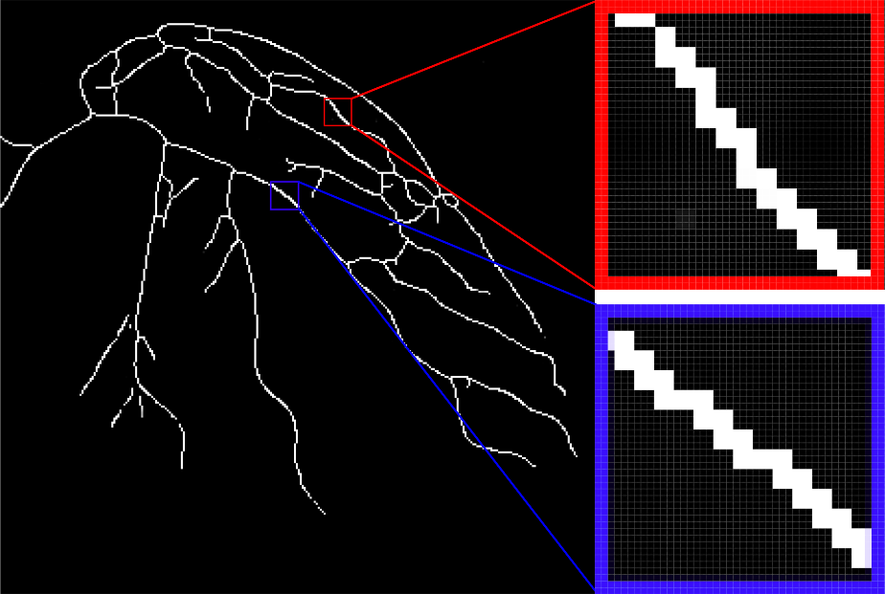
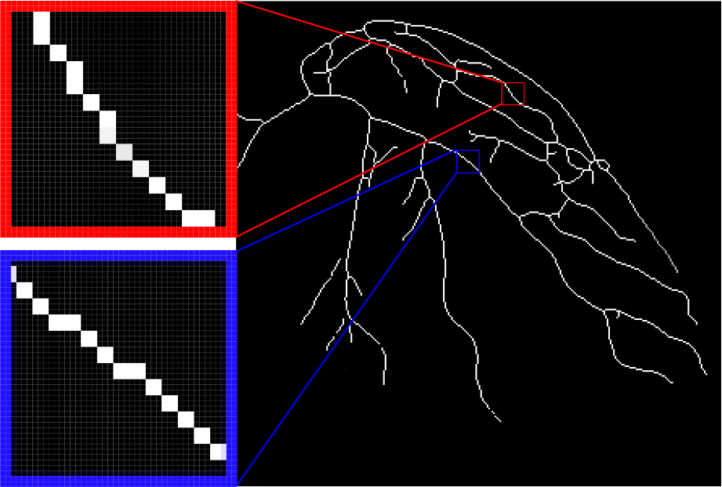
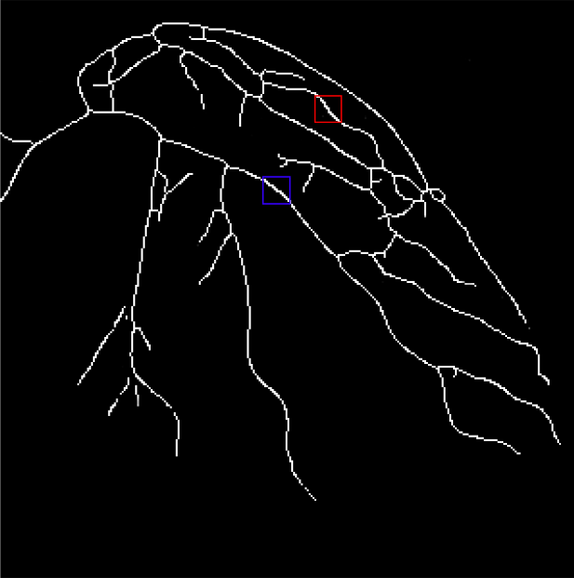
Thinning
Vessel Enhancement
Vessel Extraction
Thinning
Feature Extraction
Reconstruction
Processed binary image.
Two-step thinning result.
Refined thinning result.
Two-step Thinning
Refine-
ment
Notes:
Our thinning algorithm is based on the prior extracted vessel binary images.
First, a typical two-step thinning method is used to extract the rough skeletons.
Second, we refine the skeletons to ensure its one-pixel width and use a pattern based method to extract its bifurcations and distal nodes.
At last, we collect the skeletons from bifurcations and derive the entire structure of the skeleton tree. All these three steps are done on GPU with the help of CUDA and achieve great efficiency.
This is some comparison before and after our refinement algorithm, we can see the redundant points in the corresponding red and blue area are definitely removed
And transformed into absolutely single width skeleton. This is very important for our next feature extraction step.

Slide 15
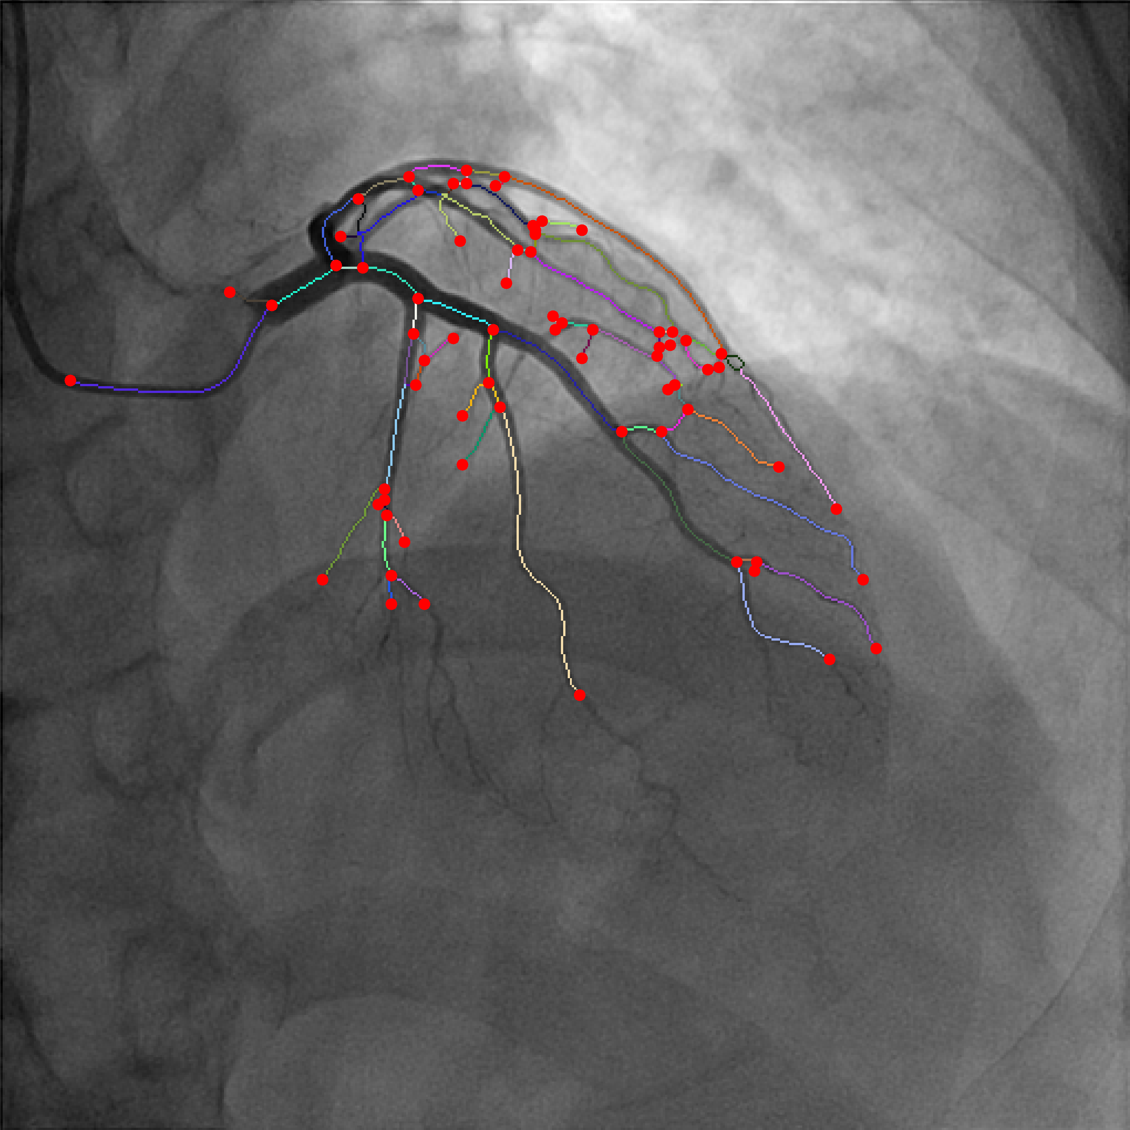
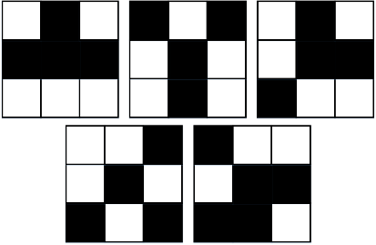
Feature Extraction
Vessel Enhancement
Vessel Extraction
Thinning
Feature Extraction
Reconstruction
Convolution
Rotate 90
Rotate 180
Rotate 270
Notes:
During the feature extraction step, we use five patterns and by changing each pattern by 90 degrees, all patterns are found.
According to the Results the image convolved with all these patterns,
points with result larger than 4 are treated as bifurcations.
Points with result twoare treated As distal nodes.
After that, a vessel segment is define as the extracted vessels between a bifurcation and a distal node or vessels between two biurcations.
After all these, vessels are extracted from the original images and divided into vessel segments using the key points information.
This figure shows our feature extraction step input and patterns we used. After the convolution, the skeletons are divided into
Segments and features such as bifurcations and distal nodes are found and labeled in red circles.

Slide 16
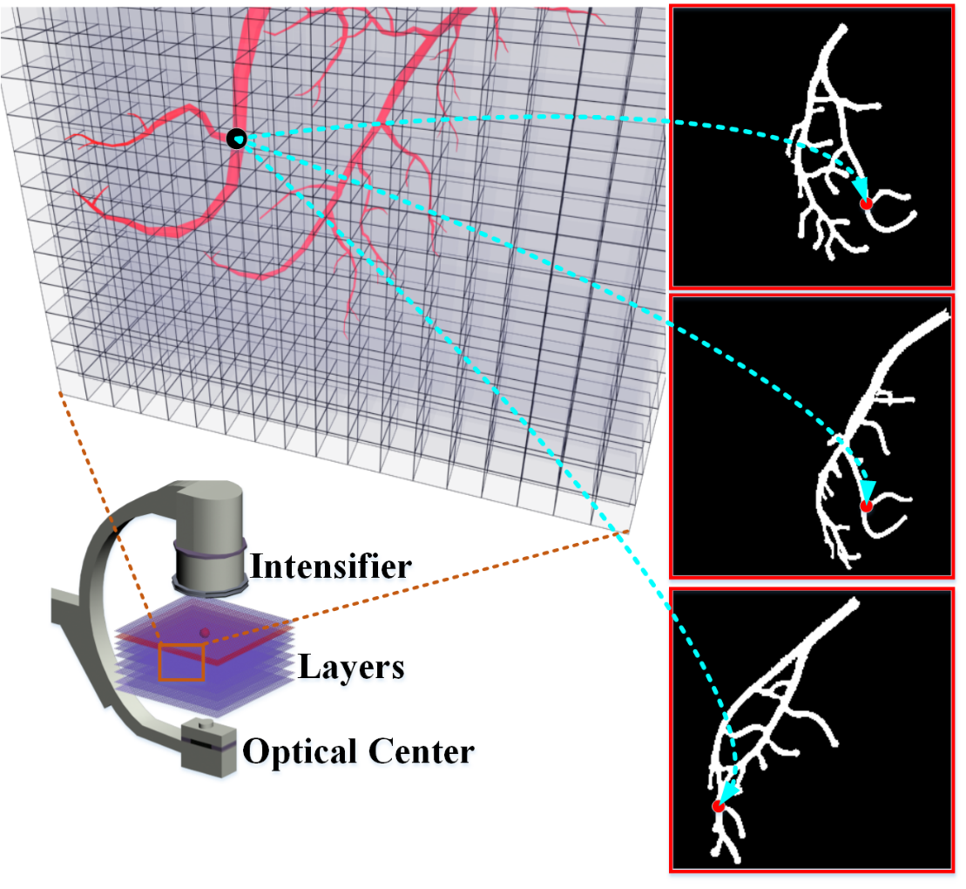
Static Reconstruction
Vessel Enhancement
Vessel Extraction
Thinning
Feature Extraction
Reconstruction
3D Space Voxel Partition
The projection of every 3D skeleton point onto the image is on 2D skeletons.
The 3D skeleton is continuous and shares almost the same topology with the 2D skeletons.
Notes:
Instead of using the typical registration methods, we discretize the space into voxels
To formulate the 3d reconstruction problem into an energy minimization problem.
This figure shows the 3d space voxel partition in our method and there are two
Obvious conditions the 3d skeletons of the vessels follow,
1st , the projection of every 3d skeleton point onto the image is on 2d skeletons.
2nd , the 3d skeleton is continuous and share same topology with the 2d skeletons.
According to the conditions we conducted from the previous analysis, we make the following
Assumptions. In fact, 3d skeletons could be regarded as a vessel tree consisting of several
Skeleton segments and each segment is made up of discretely sampled points.

Slide 17
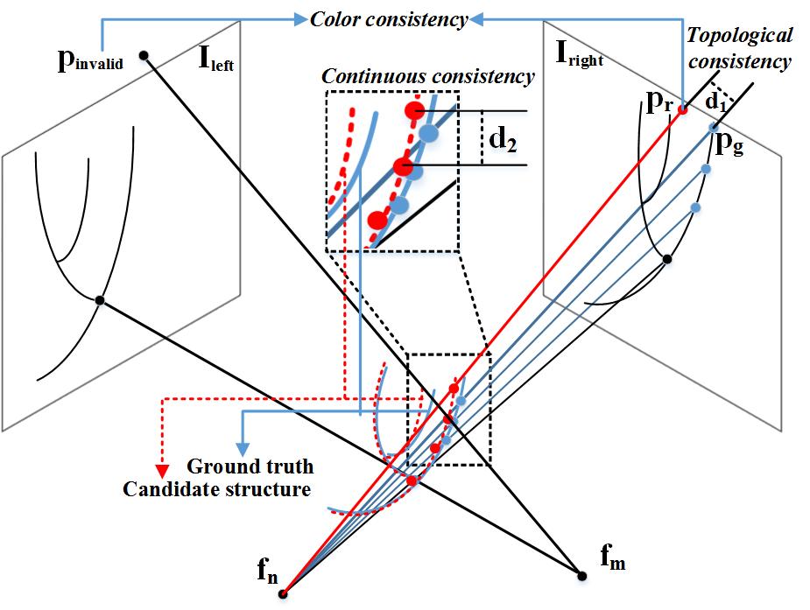
Static Reconstruction
Vessel Enhancement
Vessel Extraction
Thinning
Feature Extraction
Reconstruction
Color consistency. Number of views in which the projected point of p is valid.
Continuous consistency. Distance between p and its neighbors in the same 3D skeleton to ensure continuity.
Topological consistency. Distance between the projected 2D point and its nearest valid 2D skeleton point on the same view.
Notes:
In our method ,we quantize the space into discrete voxels. Each 3d sample point
P between the optical center and the intensifier is assigned with an probability of
Belonging to the 3d skeletons, and this can be described in the figure.
We define three terms,
the first is how many views in which the projected point of p Is valid, we call it color consistency.
The second is the distance between point p and its Neighbours in 3d skeleton to ensure continuity, we call it continuous consistency.
And The last is the distance between the projected 2d point and its nearest valid 2d point on The same view, we call it topological consistency.
Finally, the sampled 3d space could be regarded as an Markov Random Field, and the reconstruction
Problem is formulated into an energy optimization problem.

Slide 18
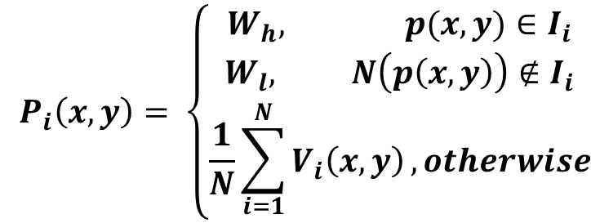
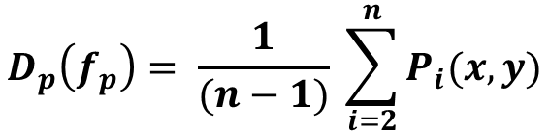
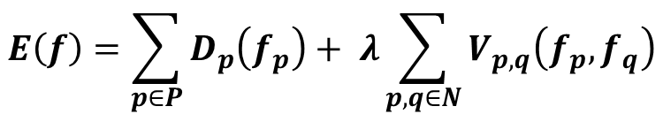




Static Reconstruction
Vessel Enhancement
Vessel Extraction
Thinning
Feature Extraction
Reconstruction
$$E\left(f\right)=\sum_{p∈P}{D_{p}\left(f_{p}\right)}+ λ\sum_{p,q∈N}{V_{p,q}\left(f_{p},f_{q}\right)}$$
Energy Function
$$D_{p}\left(f_{p}\right)$$
$$V_{p,q}\left(f_{p},f_{q}\right)$$
Distance Term
$$V_{p,q}\left(f_{p},f_{q}\right)$$
$:$Euclidean Distance between adjacent points
$$D_{p}\left(f_{p}\right)= \frac{1}{(n−1)} \sum_{i=2}^{n}{P_{i}(x,y)}$$
Color Term
$$P_{i}\left(x,y\right)= \left\{\begin{aligned}W_{h}, p(x,y)∈I_{i} \\ W_{l}, N\left(p\left(x,y\right)\right)∉I_{i} \\ \frac{1}{N}\sum_{i=1}^{N}{V_{i}\left(x,y\right)}, otherwise\end{aligned}\right.$$
Notes:
We solve the MRF problem firstly by defining the energy function. It consists of two terms.
We call V_{p,q} the distance term. It represents the Euclidean distance between adjacent points.
This term is designed for the topological consistency.
We call the Dp(fp) color term, where n is the number of back projected points, Pi(x,y)
Is the projection value of point p on the i-th view, and it is based on the neighbor number of
The evaluation point p(x,y) . For a grey scale image, N(p(x,y)) represents the eight neighbours
Of point p(x,y).
For each image pair’s reconstruction, we choose three views of angiograms in a cardiac cycle and
Choose the projection view I1 as the reference view with least foreshortening and overlapping among all views.

Slide 19
Static Reconstruction
Vessel Enhancement
Vessel Extraction
Thinning
Feature Extraction
Reconstruction
Update policy
  Message propagation
$$V_{p}=V_{p−1}+ αminD+\left(1−α\right)V_{p_{minD}}$$
  Energy minimization
$$e_{i}\left(p_{i}\right)=min⁡[ΥD\left(p_{i}, q\right)+\left(1−Υ\right)V\left(q\right)+ e_{i−1}(q)]$$
Notes:
We find the minimum cost of E using the belief propagation algorithm and this method is composed
Of two steps, message propagation and energy minimization.
In message propagation, the color of the point p(x,y) is updated using it prior values. MinD represents
The minimum distance from p to its neighbours.
In energy minimization, the current energy of the i-th depth is defined as ei and it is also a procedural update.

Slide 20



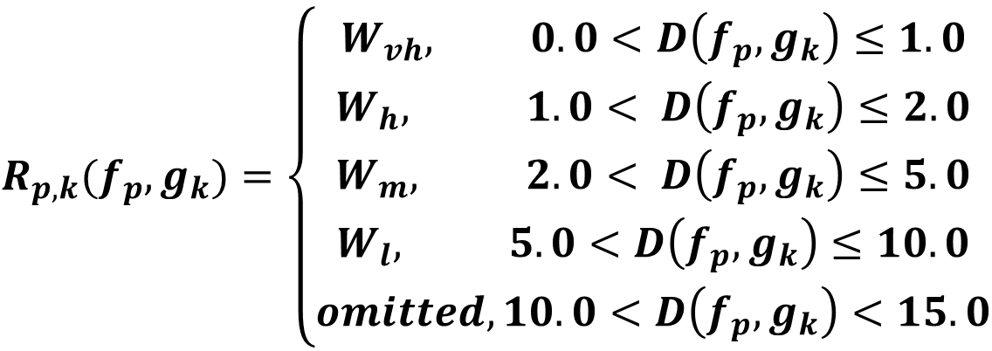
Motion Reconstruction
Vessel Enhancement
Vessel Extraction
Thinning
Feature Extraction
Reconstruction
Energy Function Reformulation
$$E\left(f\right)$$
$$R_{p,k}(f_{p},g_{k})$$
$$E^{′}\left(f\right)=E\left(f\right)+ R_{p,k}(f_{p},g_{k})$$
$$R_{p,k}(f_{p}, g_{k})=\left\{\begin{aligned}W_{vh}, 0.0<D\left(f_{p}, g_{k}\right)≤1.0 \\ W_{h}, 1.0< D\left(f_{p}, g_{k}\right)≤2.0 \\ W_{m}, 2.0< D\left(f_{p}, g_{k}\right)≤5.0 \\ W_{l}, 5.0<D\left(f_{p}, g_{k}\right)≤10.0 \\ omitted, 10.0<D\left(f_{p}, g_{k}\right)<15.0\end{aligned}\right.$$
Notes:
Based on the static reconstruction, we continue to generalize the algorithm to track
The vessels’ motions. Due to the characteristics of hearts’ motions, skeletons should be
Just changed from its proceeding pose and changed slightly to its subsequent pose. So, if
We consider the reconstruction during frames, reconstructed vessels of this frame can be regarded
As prior knowledge in the next frame. In our method, this is done by re-weighting the sampled valid
Points according to the distance to their corresponding prior points.
Therefore, we reformulate the energy equation using the new Constraint, R_{p,k}, This term is used to
Attract the shape not going far away from its prior shape. It is a piecewise linear function based on the
Distance of valid point to its corresponding prior.

Slide 21
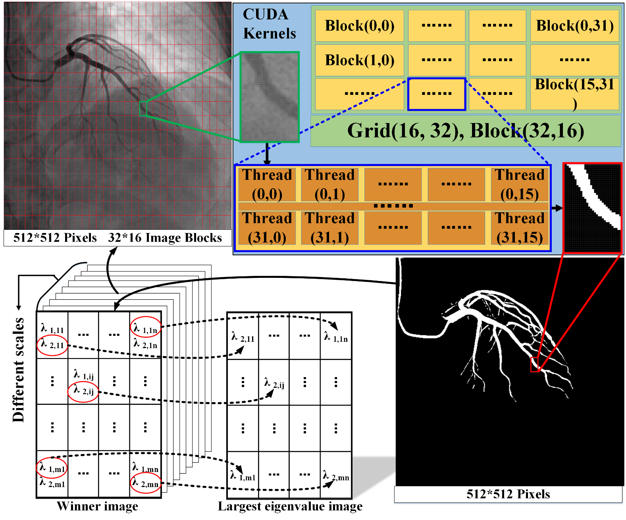
Parallelized Implementation
Vessel Extraction
Notes:
This is the sketch up of our CUDA based vessel extraction steps. Firstly, the image is divided into 32
Multiply 16 image blocks. Each block contains 16 multiply 32 pixels and each pixel corresponds one cuda
thread. For each sigma,
First, we build the Gaussian kernel mask depending on σ on CPU side and transfer them into the GPU.
Second, we convolve the entire image using this Gaussian kernel.
Third, we extract the eigenvalues and eigenvectors and compute the coefficients for each point’s Hessian matrix. This is also done per thread on GPU.
Finally, we use a double swap buffer on GPU to compute the possibility of a pixel being part of vessel Structures.
In all the procedures, except initialization, data are on GPU side and stored for further processing.

Slide 22
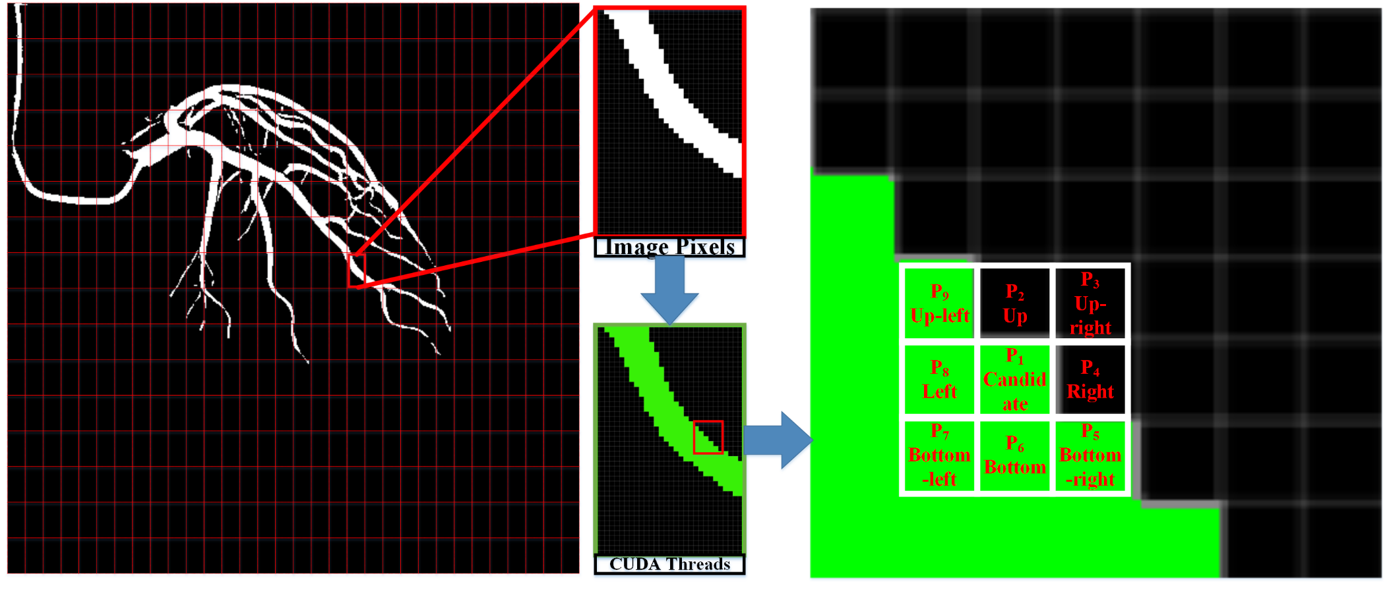
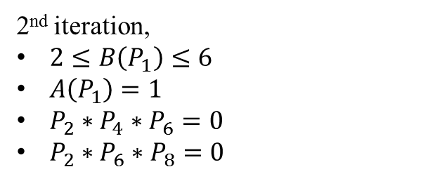
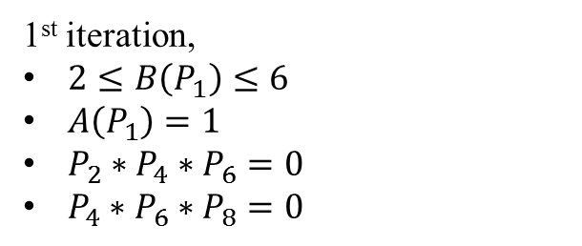
Parallelized Implementation
Thinning
1st iteration,
$2≤B\left(P_{1}\right)≤6$
$A\left(P_{1}\right)=1$
$P_{2}∗P_{4}∗P_{6}=0$
$P_{4}∗P_{6}∗P_{8}=0$
2nd iteration,
$2≤B\left(P_{1}\right)≤6$
$A\left(P_{1}\right)=1$
$P_{2}∗P_{4}∗P_{6}=0$
$P_{2}∗P_{6}∗P_{8}=0$
$B\left(P_{1}\right)=P_{2}+P_{3}+…+ P_{8}+ P_{9}$, $A\left(P_{1}\right)=01 patterns in set P_{2}P_{3}… P_{8}P_{9}$
Notes:
This is the sketch up of the thinning step. The whole image is mapped to the cuda kernel, each image pixel
Corresponds to one cuda thread. For each thread on GPU, we compute the number of its eight neighbours.
This is described in the right figure. Each cuda thread is responsible for one candidate P1,
P1is removed if it fulfills any of the following condition. As all candidates are mapped to CUDA threads, the
Whole processing step is very fast.

Slide 23
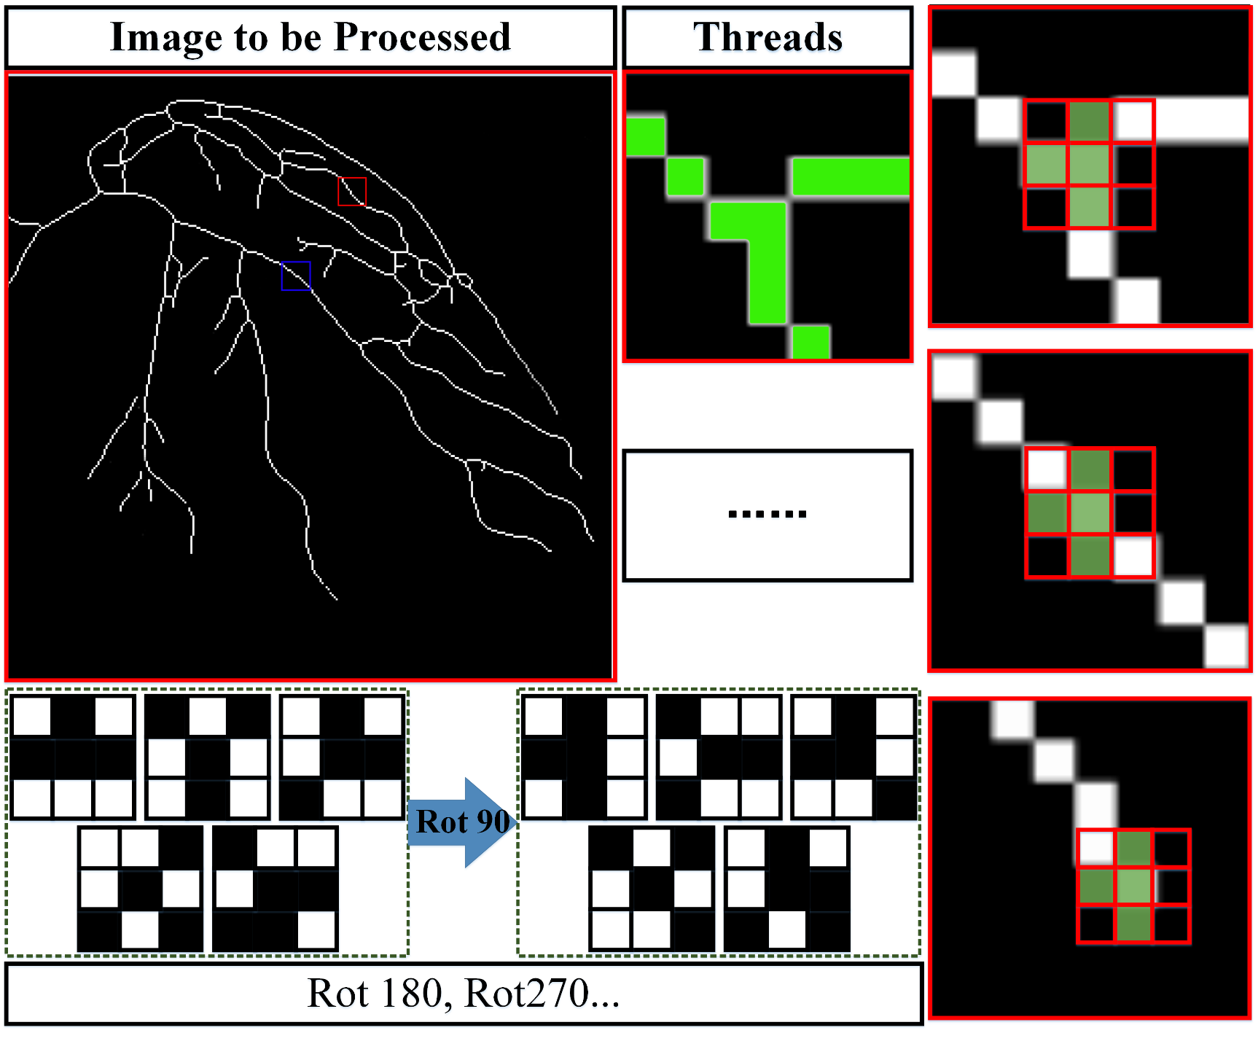
Parallelized Implementation
Feature
Extraction
Notes:
This is the sketch up of our CUDA based feature extraction. Each skeleton point corresponds to one cuda thread.
We convolve the whole image with the patterns, and for each skeletons point, according to the convolution result,
It is recognized as different types. The right figures show three different point types, they are
Bifurcations, normal nodes and distal nodes.

Slide 24
Outline
Introduction
Algorithms
Results
Conclusions

Slide 25
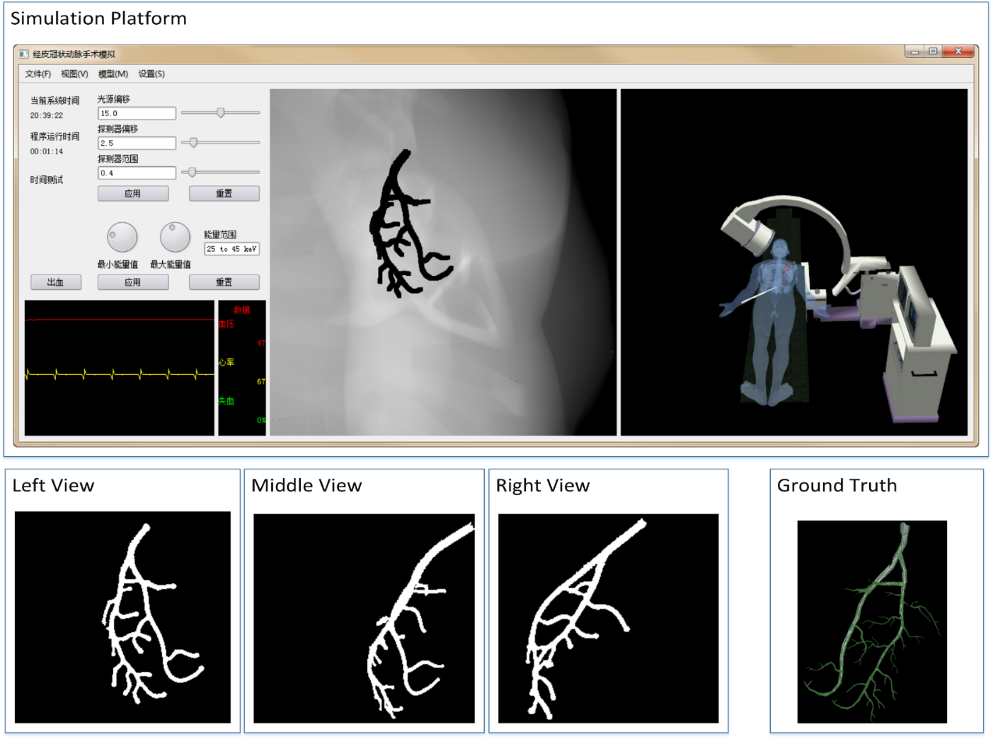
Data Acquisition
Synthetic Data
Notes:
This is the platform we use to acquire the synthetic data. The top row shows a snap of our
Platform. The down row shows three different views of the extracted synthetic data.

Slide 26
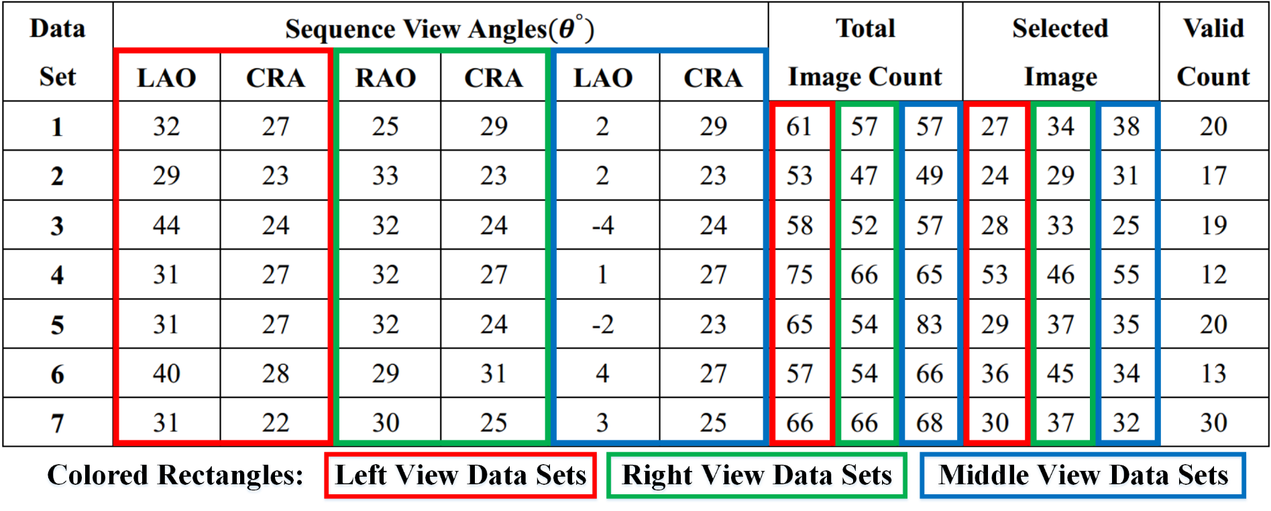
Data Acquisition
Real Data Set Table
Notes:
In our experiments, we use seven sets of clinical data. Each set contains more than fifty images at three
Different angles. The first sequence is selected as the reference view. According to the ECG-gating data,
Corresponding images in different views are labeled and selected as show in the table.
Totally, we reconstructed 131 pairs of vessels from the sequence.

Slide 27
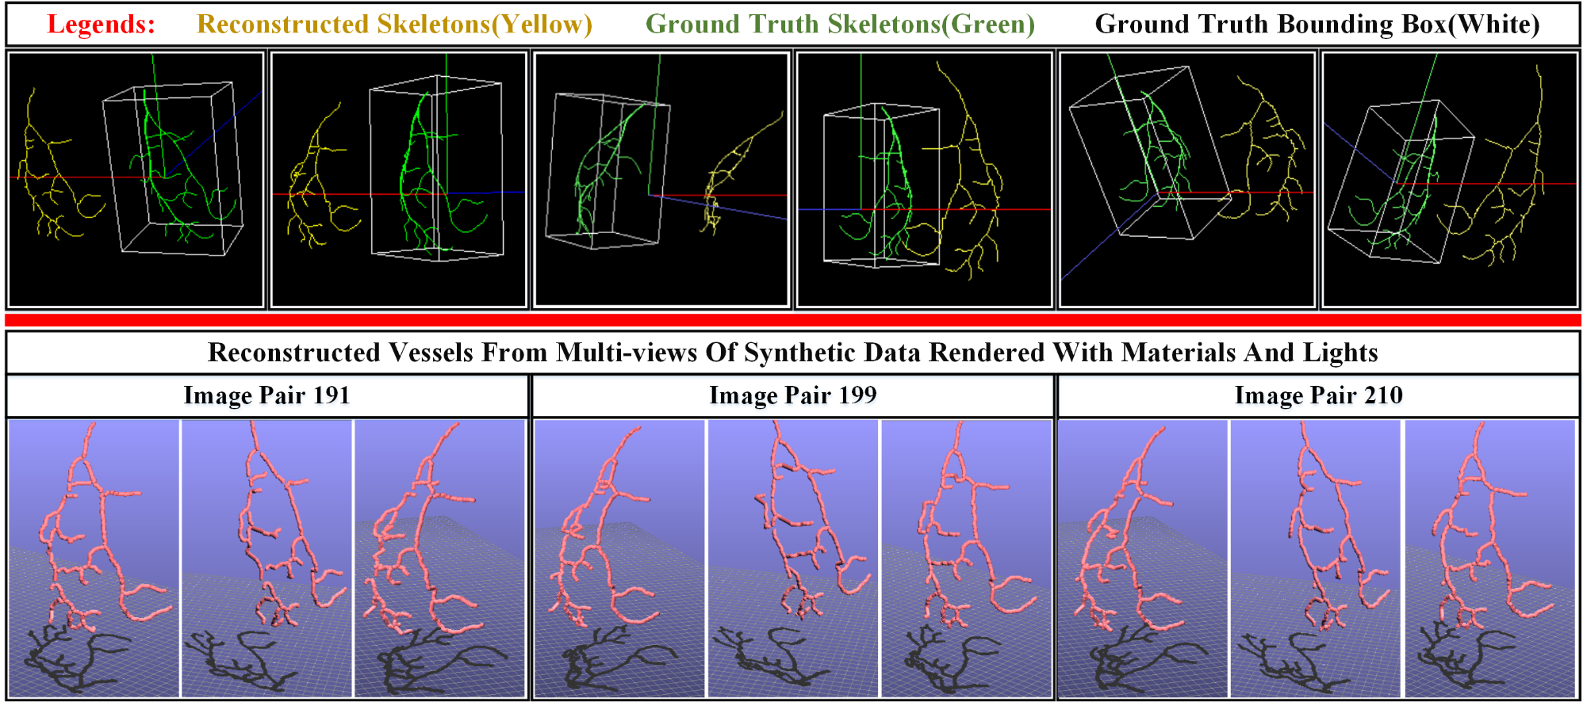
Reconstructed Synthetic Data
Notes:
In the top row of the figure, the yellow lines
indicate the reconstructed skeletons using our method. The green lines
indicate the ground truth of the synthetic data. The white box is the
bounding box of the ground truth. The down row represents three pairs of
reconstructed vessels with materials and lights.

Slide 28
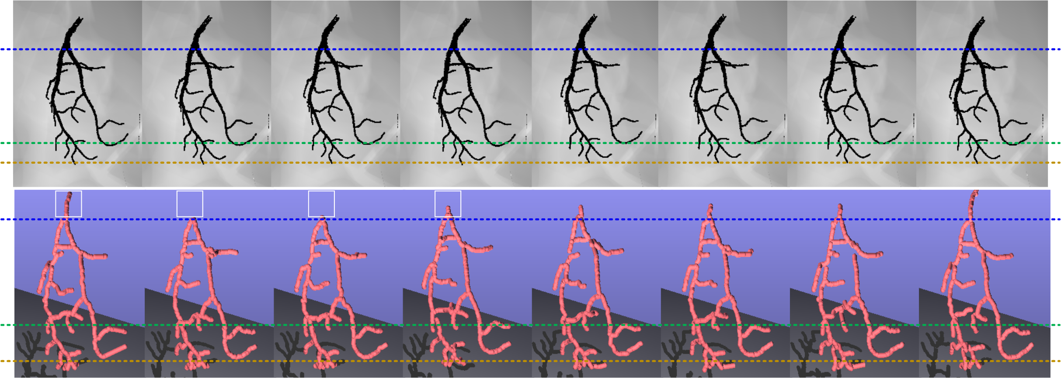
Reconstructed Synthetic Data
Notes:
This figure shows the robustness of our method. Our reconstruction result will be automatically
Refixed for our method’s global optimization nature.

Slide 29
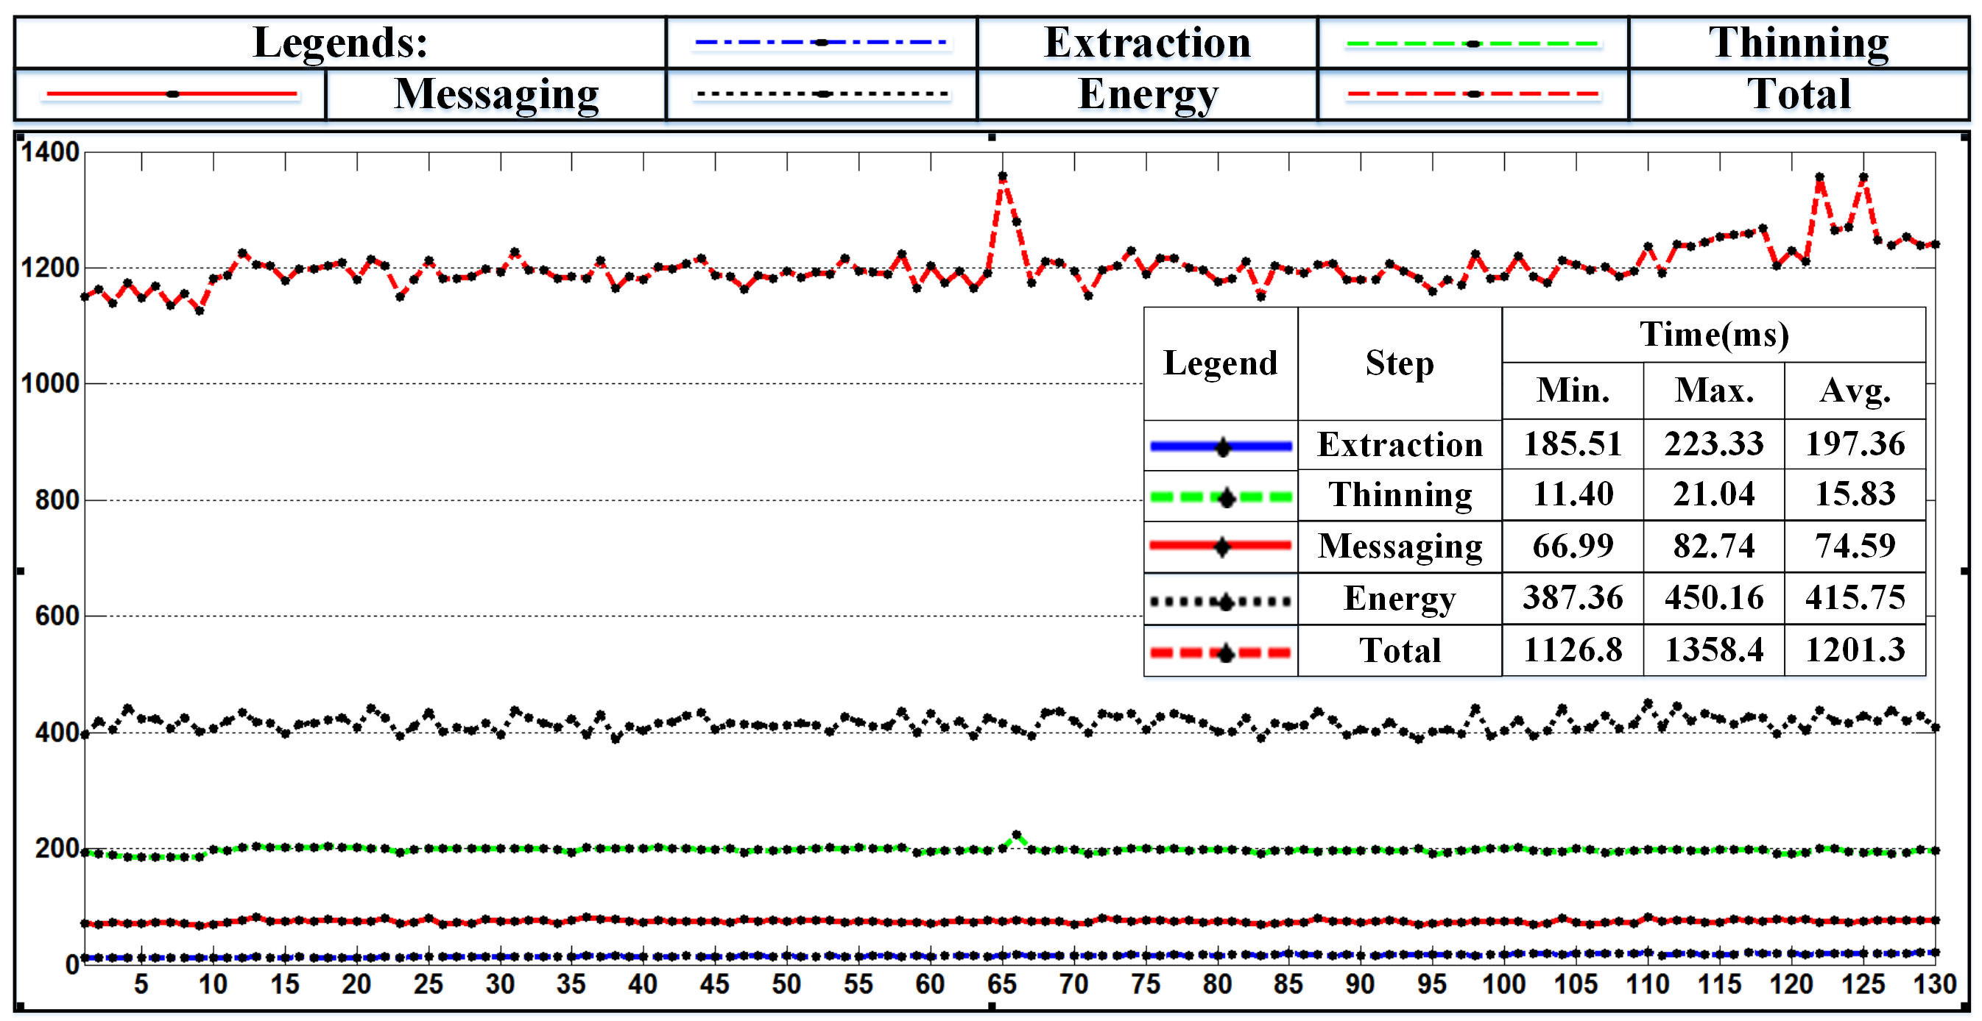
Timing
Notes:
This is the timing statistics for 130 image pairs of synthetic data. Different legends are used to indicate timing for different steps.
Since the synthetic data is simple and share almost the same topology, the processing time is stable among all pairs. The whole
Processing time is almost one thousand and two hundred milliseconds.

Slide 30
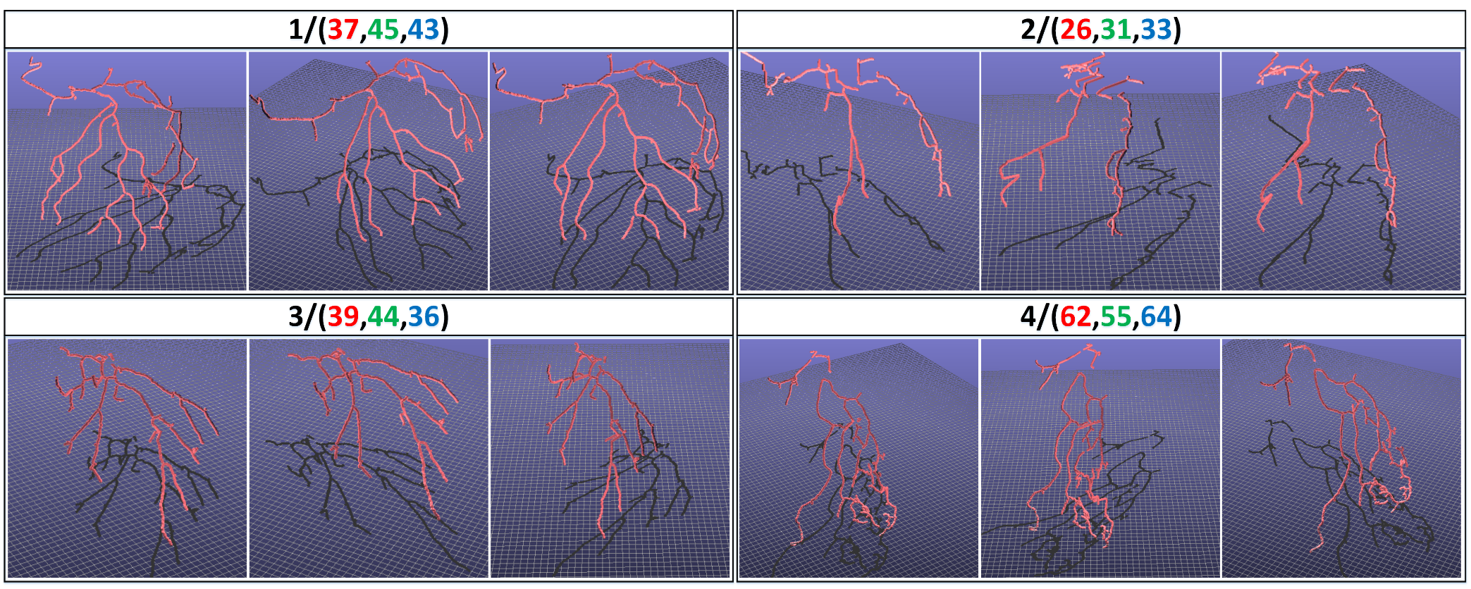
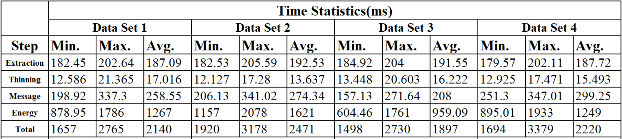
Reconstructed Clinical Data
Notes:
This figure shows reconstructed clinical data. Seven data sets are considered. Four reconstructed pairs are presented including one for data set 1-4 respectively. Color codes are used to specify the number of the data set and selected views.
The statistical timing is also shown, the minimum, maximum and average timing for each data set are also shown.
Due to the complexity of clinical data, processing time is longer than that of the synthetic data.

Slide 31
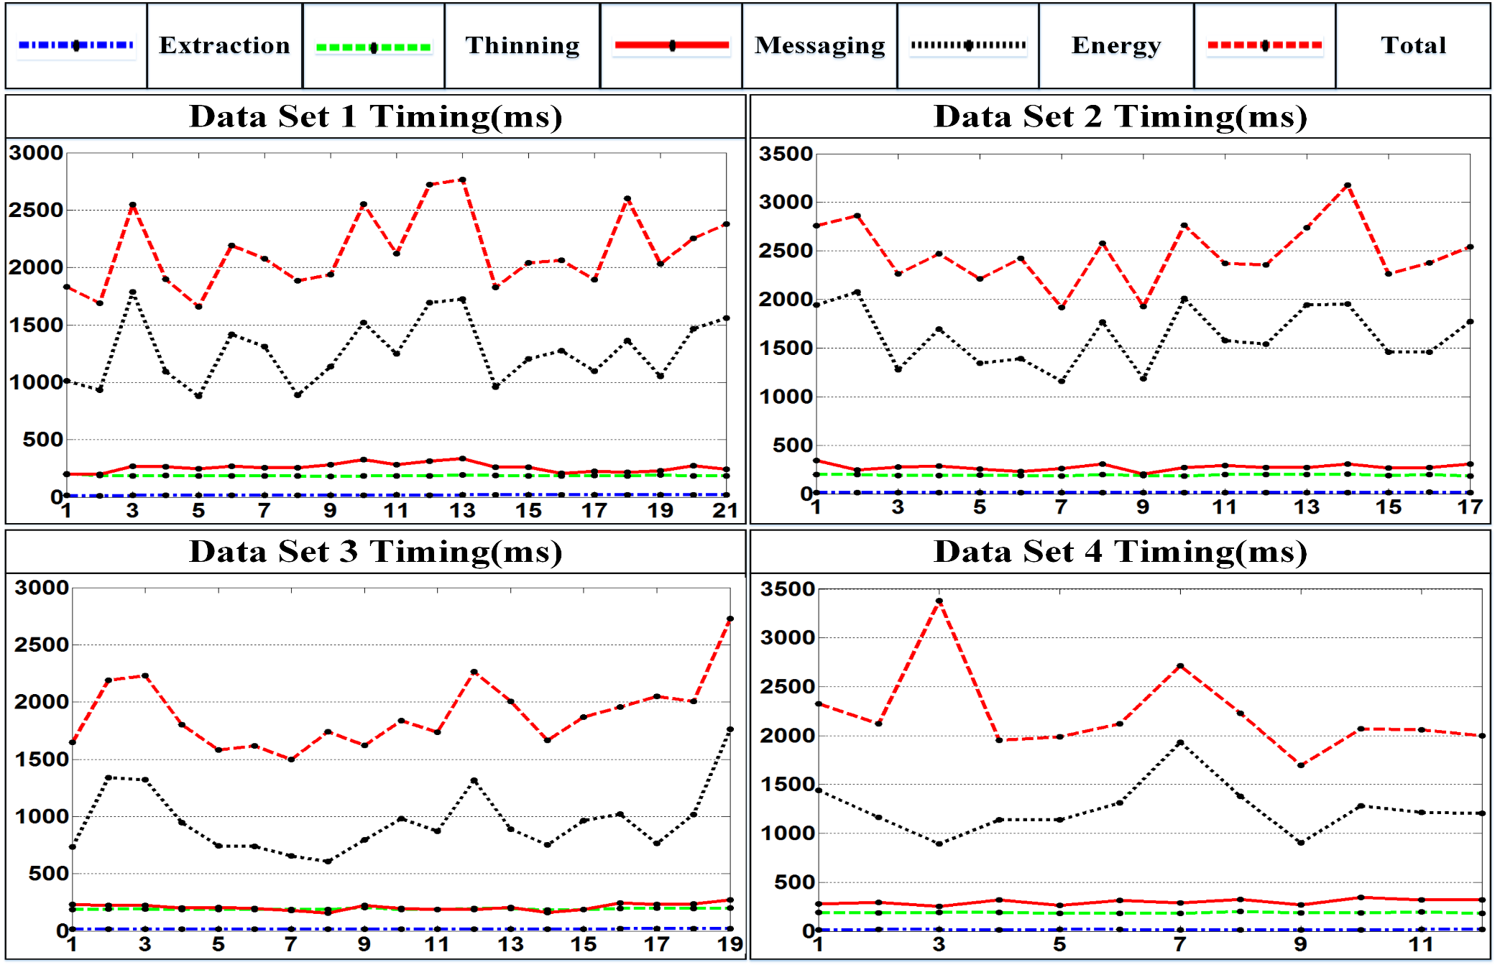
Timing
Notes:
And, again ,this is the timing figure for each of the four data sets. The preprocessing step is well parallelized and is
Always stable. The messaging and energy step are partly parallelized and are sensitive to input complexity. However,
The whole reconstruction time is under three seconds.

Slide 32
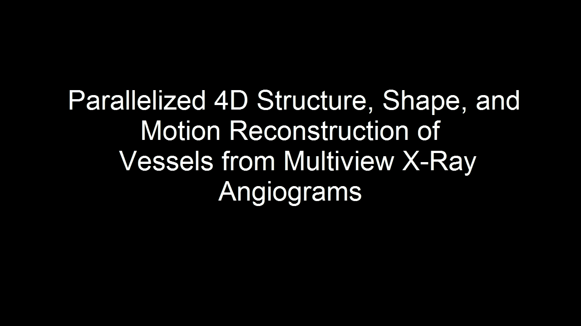
Reconstructed Clinical Data
Notes:
So. This table shows the statistics for each reconstructed vessels.

Slide 33
Outline
Introduction
Algorithms
Results
Conclusions

Slide 34
Conclusion
We have developed a new 4D dynamic vessel reconstruction system from X-ray angiograms.
We have gained great efficiency in vessel extraction and thinning with the help of CUDA technology.
We have presented an algorithm to formulate the dynamic reconstruction problem as an optimization problem and solved by belief propagation without explicit registration.
Experimental results have shown our method is robust for the global optimization nature and fast with the help of CUDA.
Notes:
In our experiments, we use seven sets of clinical data. Each set contains more than fifty images at three
Different angles. The first sequence is selected as the reference view. According to the ECG-gating data,
Corresponding images in different views are labeled and selected as show in the table.
Totally, we reconstructed 131 pairs of vessels from the sequence.

Slide 35
This work is supported in part by National Natural Science Foundation of China (Grant No. 61190120, 61190121, 61190125, 61300068, 61300067), National Science Foundation of USA (Grant No. IIS-0949467, IIS-1047715, and IIS-1049448), the National High Technology Research and Development Program(863 Program) of China (Grant No. 012AA011503), Postdoctoral Science Foundation of China (Grant No. 2013M530512).

Slide 36
Parallelized 4D Structure, Shape, and Motion Reconstruction of Vessels from Multiview X-Ray Angiograms
Thank you!
Notes:
So that’s all, thanks.

Slide 37
Parallelized 4D Structure, Shape, and Motion Reconstruction of Vessels from Multiview X-Ray Angiograms
Any questions?
Notes:
So that’s all, thanks.

